Slide 1
Resource Management
TOPIC 6.0 – RESOURCE MANAGEMENT
TOPIC 6
6.1.5: Operating System

Slide 2
AGENDA
THE AGENDA
Warm Up Question
6.1.1-6.14
Operating Systems
Program Management
Memory and CPU
Paging and Scheduling

Slide 3
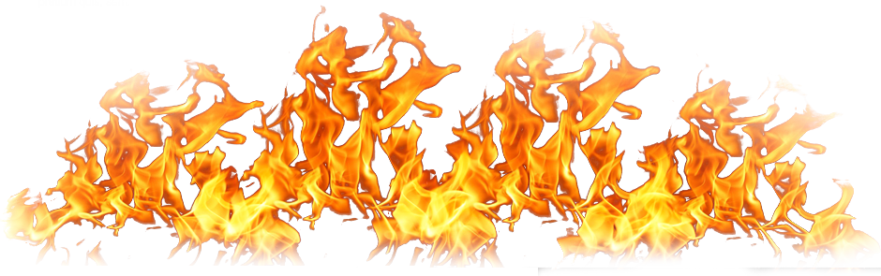
REVIEW REVIEW REVIEW REVIEW REVIEW REVIEW
THE WARM-UP QUESTION
What’s the difference between multiprogramming, multitasking, multithreading, and multiprocessing?

Slide 4
REVIEW REVIEW REVIEW REVIEW REVIEW REVIEW
THE WARM-UP ANSWER
Multiprogramming – processor switching which program is running
Multithreading – programs are designed with multiple threads to switch between to utilize the CPU and improve responsiveness
Multitasking – programs give the CPU small tasks to run rather than entire programs
Multiprocessing – a system with multiple processors that’s able to handle multiple programs or tasks simultaneously

Slide 5
TOPIC 6.1.5 – ROLE OF THE OS
OPERATING SYSTEMS
Recall that operating systems are the layer that our applications run on
We’re going to dive into more depth about how an OS operates on a technical level

Slide 6
TOPIC 6.1.5 – RESOURCE MANAGEMENT
OS LANGUAGES
An operating system communicates with the base level of the computer
Certain parts are written directly in assembly to communicate with the hardware
Certain parts are often written in C or C++, to speed up development time
Computers are fast enough nowadays to have very little penalty for doing this

Slide 7
TOPIC 6.1.5 – ROLE OF THE OS
OS ROLE
The operating system’s role is to interface with the system’s hardware
The OS coordinates uses of all the system resources we discussed last time
Controls where applications are stored on drives
Calculate and designate RAM for different apps
Copy the application to RAM

Slide 8
TOPIC 6.1.5 – ROLE OF THE OS
MANAGING MEMORY
Given that RAM is usually small compared to secondary storage
RAM must be managed efficiently to achieve the best performance
RAM should hold only vital data
What should happen when you exit a program?

Slide 9
TOPIC 6.1.5 – ROLE OF THE OS
EXITING PROGRAM
When you exit a program the memory it was using should be freed up
When this doesn’t happen, we have a memory/resource leak
OS should be able to dynamically allocate and deallocate memory based on current program needs as well

Slide 10
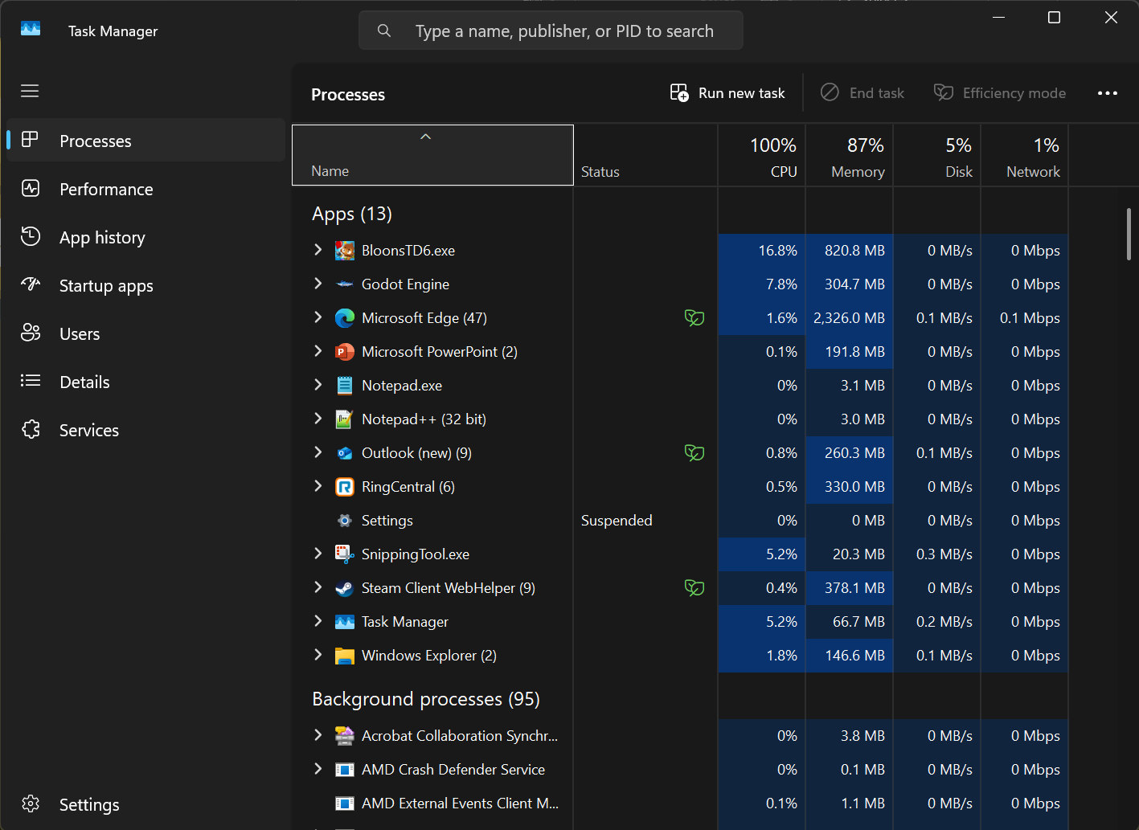
TOPIC 6.1.5 – ROLE OF THE OS
PROGRAM MANAGEMENT
To provide these functionalities, the OS must keep track of the currently running programs
You can see your computer do this in real time by opening the task manager
It also shows how much of each resource is being used

Slide 11
TOPIC 6.1.5 – ROLE OF THE OS
ADDRESSES
The OS must keep track of the location of the programs within RAM to achieve these functions
The logical location of items in memory
Variable names don’t represent where values are stored in memory
The OS converts the logical addresses into physical RAM hardware addresses
This way the computer can actually fetch that data
This process is called Address Binding

Slide 12
TOPIC 6.1.5 – ROLE OF THE OS
SWAPPING
What happens when RAM fills up, even with the OS on its best behavior?
The OS will have to swap out a process (or parts of one) to your secondary storage
This will then be brought back in to RAM to continue running the program
Swapping is a vague term for this, but how does it actually work?

Slide 13
TOPIC 6.1.5 – ROLE OF THE OS
PAGING
We talked briefly about paging during our last unit
Paging is an implementation of virtual memory, which allows the OS to use secondary storage as if it was RAM
If the OS needs something to be in RAM that’s in secondary storage, a group of data (called a page), is swapped out from RAM to the disk, and a group is brough into RAM off the disk
What happens when data constantly gets swapped to and from the disk?

Slide 14
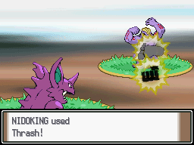
TOPIC 6.1.5 – ROLE OF THE OS
THRASHING
Thrashing occurs when pages of memory get swapped in and out constantly
This is a large performance penalty if the OS constantly must rely on the slower secondary storage

Slide 15
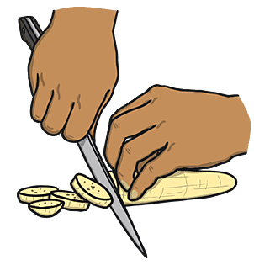
TOPIC 6.1.5 – ROLE OF THE OS
SLICING
So, we’ve talked about how the system handles multiple programs in memory, but what about with the CPU?
A slice is the time given to each program in a multitasking or multiprogramming system
After a time slice is up, the CPU switches to the next program
This typically happens in millisecond intervals, so it’s unnoticeable to us and makes the computer appear smooth
Multiple time slices are run at once on multiprocessor computers

Slide 16
TOPIC 6.1.5 – ROLE OF THE OS
INTERRUPTS
To actually switch tasks the OS sends out Interrupts that suspend a current process
It then identifies the next process to be executed
The next process is chosen by a process called a scheduler that gets run once every time slice
Modern OSes can remember the state that programs were in so switching can be resumed exactly precisely
How does the scheduler decide which program gets to run next?

Slide 17
TOPIC 6.1.5 – ROLE OF THE OS
PRIORITY
The scheduler has a few options to decide which program goes next
We will discuss these in depth during our next lesson

Slide 18
TOPIC 6.1.5 – ROLE OF THE OS
MANAGING PERIPHERALS
Peripherals have a lot of variety as they vary in characteristics
Device Drivers help to handle all peripheral communication
These are small programs that are specialized to certain devices

Slide 19
TOPIC 6.1.5 – ROLE OF THE OS
MANAGING PERIPHERALS
Peripherals that provide input often use interrupts to ensure the program feels responsive
Whenever I use my mouse, the computer immediately responds, rather than waiting for the mouse
Interrupts can also be served by internal components
If you fetch data from secondary storage, an interrupt is served

Slide 20
TOPIC 6.1.5 – ROLE OF THE OS
DEVICE MANAGER
To get a more in depth look at what our system is doing
And what devices it’s connected to
We can open the Windows Device Manager
Click the Windows key and type device manager, and it should be the first thing to pop up

Slide 21
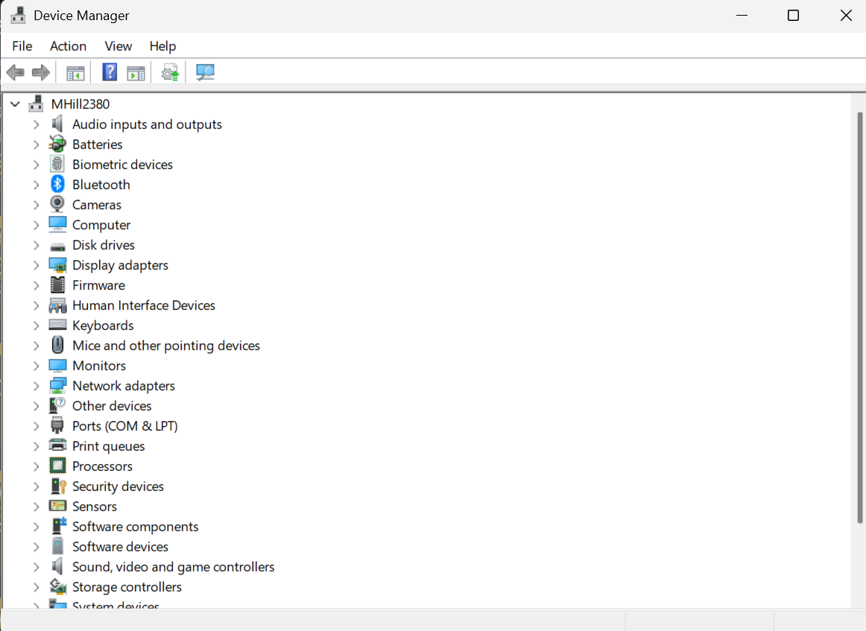
TOPIC 6.1.5 – ROLE OF THE OS
DEVICE MANAGER
Here you get the option to disable peripherals or update drivers

Slide 22

TOPIC 6.1.5 – ROLE OF THE OS
MANAGING PERIPHERALS
The OS can utilize all of this so developers of applications don’t have to program the hardware details themselves
ABSTRACTION

Slide 23

TOPIC 6.0 – COMPUTER ORGANIZATION
VOCAB TO REMEMBER
Paging
Thrashing
Slicing
Interrupts
Priority
Peripheral

